Slide 1

Market
Analysis

Slide 2

Agenda
This orientation will cover:
Timeline of Annual Compensation Activities (before Focal)
MA Overview
Methodology
Compensation Philosophy
Pay Position
Cost of Labor
Frequency of Analysis
Pay for Performance
Budget Planning
What Comp Will Be Sharing With HRBPs?
Sample Exhibit of Market Analysis Results
APPENDIX
Supply and Demand
Selecting the Right Survey
Comp Key Terms
Common FAQs
For Illustration Purposes Only*

Slide 3
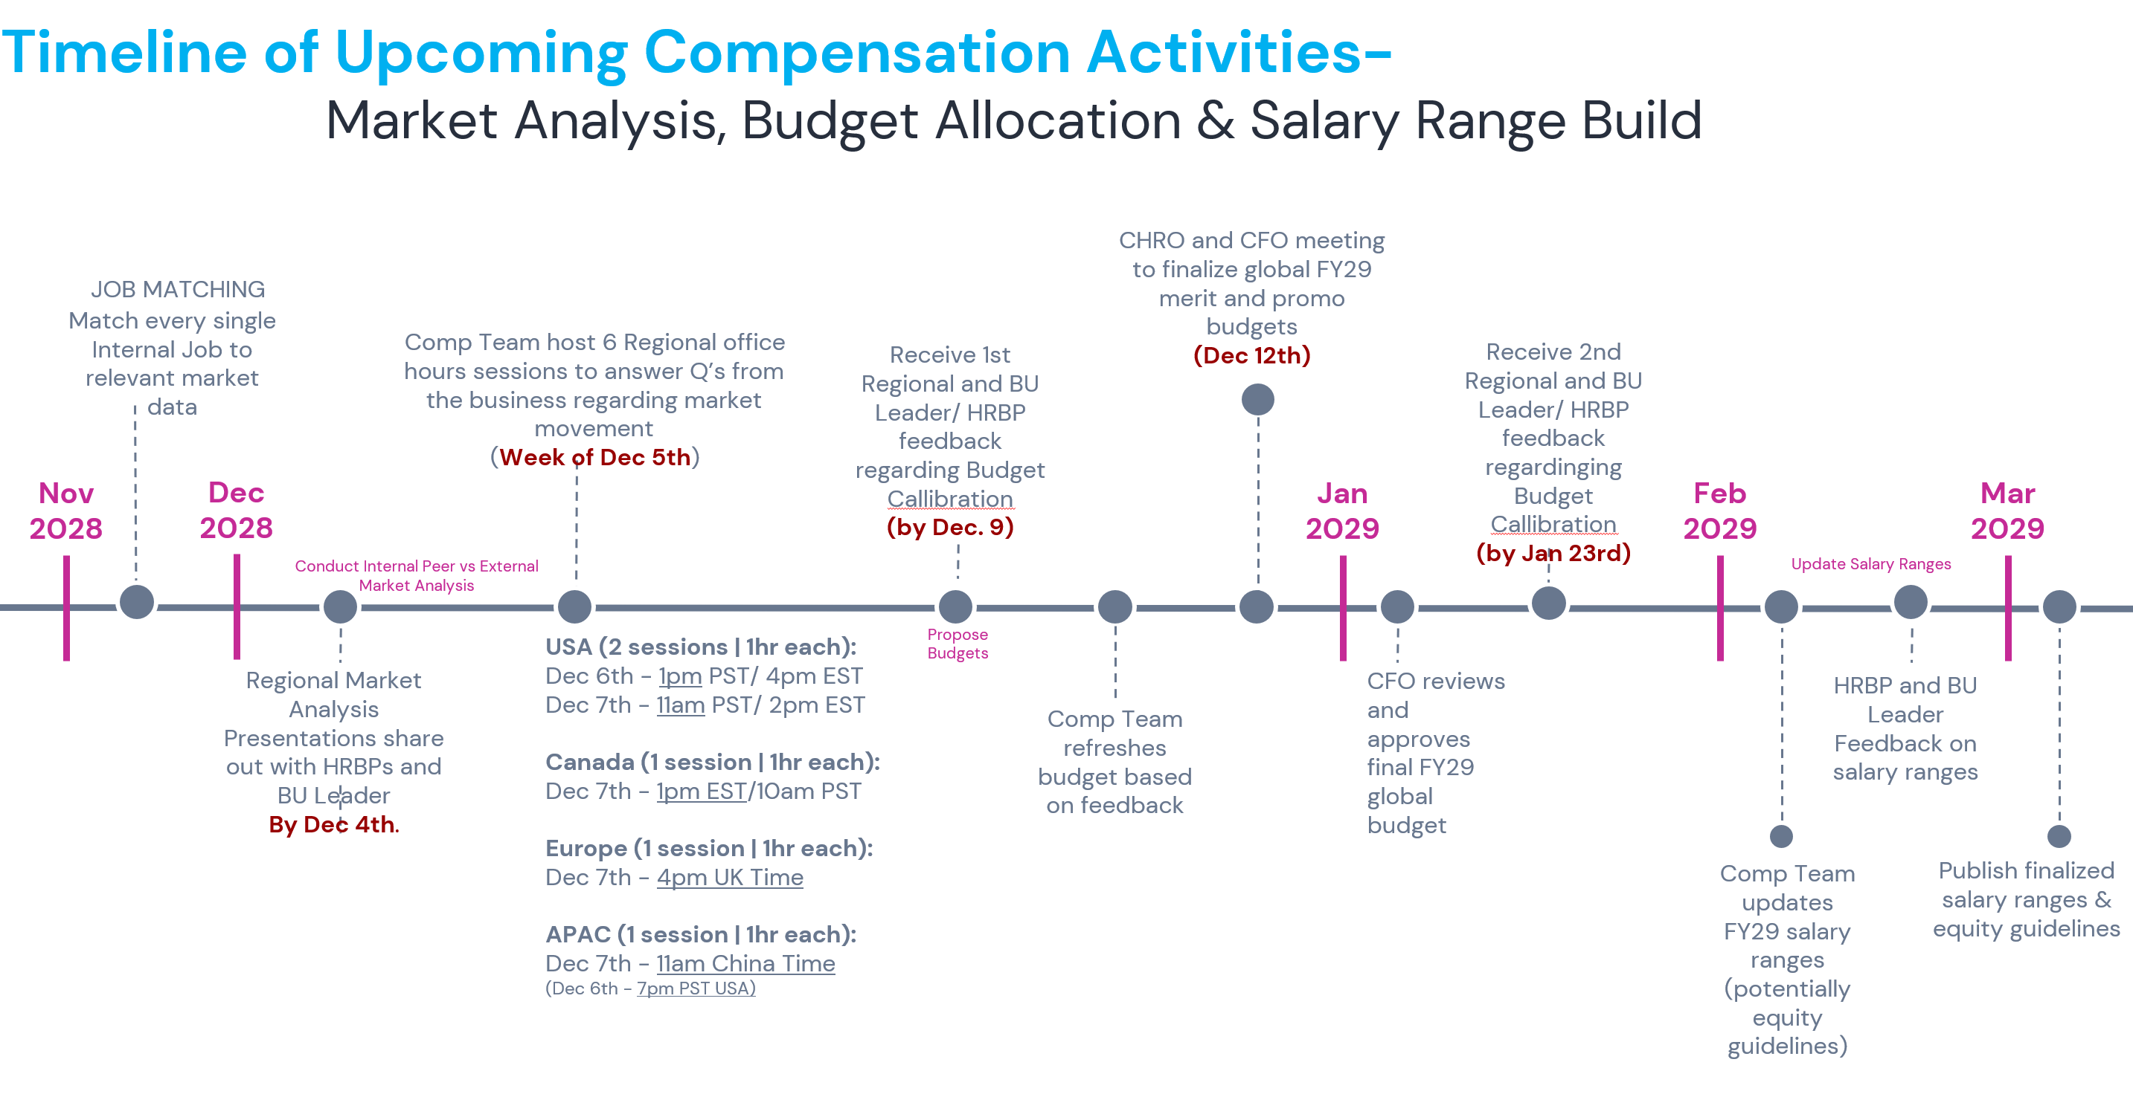
For Illustration Purposes Only*

Slide 4

MA OVERVIEW

Slide 5

Market Analysis Overview
The objective of market analysis is to determine the market pay level as defined by our compensation philosophy.
We want to be more proactive vs reactive to market changes. By synthesizing data insights from the past, referring to survey data, best practices, methodologies, and most importantly listening to feedback from business stakeholders, it will help us indicate if we need to price a job or benchmark out of cycle.
When we benchmark our pay against other companies with similar jobs, we can identify any large, unexplainable disparities.
Analyzing pay can have a huge impact on retaining and attracting top talent, improve job satisfaction, morale, budgeting, performance, and maintaining internal and external equity.
For Illustration Purposes Only*

Slide 6
Market Analysis Overview
At its simplest level, market analysis is one factor that informs employee pay decisions.
These decisions include our merit budget and where we set pay ranges.
It is an important input to these decisions, but not the only variable being considered.
Market analysis is the biggest part of this
Pay position
Business perspective on value and need
Financial affordability
Employer brand and other qualitative factors
Business calibration
Decisions
For Illustration Purposes Only*

Slide 7
METHODOLOGY

Slide 8
COMP PHILOSOPHY IN ACTION
The key features of our methodology are reflections of our comp philosophy in action, including:
Our company peer group (competition for talent)
Our target pay against market (50th P, 65th P, 75th P…)
Setting pay ranges based on local cost of labor
Updating our pay positions regularly
Pay for performance
Balancing with affordability and compliance
We will explore each of these in detail, including implications for our work and comp programs
For Illustration Purposes Only*

Slide 9

COST OF LABOR
We evaluate and set pay based on geo tier locations, job levels, and job families.
We budget salary structures based on cost of labor. We keep an eye on cost of living-and consumer price index (inflation) data during year end merit planning cycles.
For Illustration Purposes Only*

Slide 10
ANNUAL PAY REVIEW
Pay Updates Every Year
We conduct a deep analysis and make updates annually to our programs, pay ranges, etc.
Not All Companies Update Pay Ranges Every Year
We do look to be responsive, i.e. if we see our employees’ pay falling behind or getting ahead of market rates, we will react to the extent we can that year rather than having a default approach of waiting to see a longer trend.
Contextualizing the Bigger Picture
Our responses to market movements also contextualize the implications to pay within teams and organizations at COMPANY X We work closely with our HRBPs to keep the bigger picture in mind when making pay decisions, i.e., how increasing a pay range for one job impacts the pay for the levels above and below that job in the same family.
For Illustration Purposes Only*

Slide 11
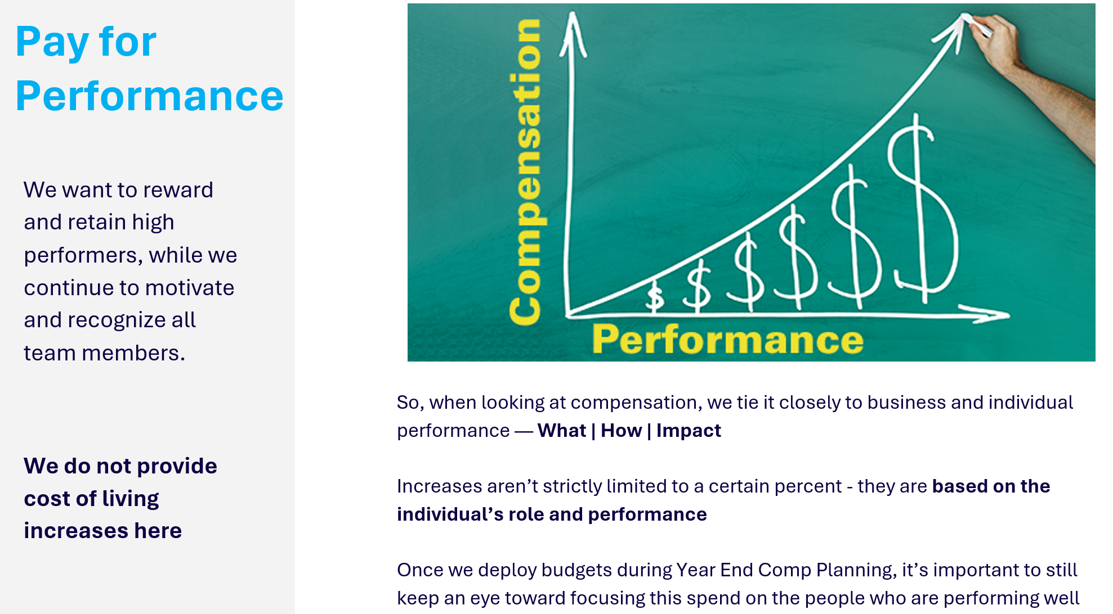
For Illustration Purposes Only*

Slide 12
BUDGET ALLOCATION

Slide 13

BUDGET ALLOCATION
Affordability and Compliance
While we look to be responsive and keep a competitive pay position to market, we also have to be financially responsible
E.g. we see market data moving by X%, but we don’t have any issues attracting or retaining talent. Should we necessarily match the market exactly? Related, these budgets have many draws on them, for example hiring and promotions. How we manage the whole system is really important
“There is no magic merit money sitting in a drawer within Finance or Comp. This is a cost that hits your businesses directly.”
Total Rewards | Compensation
For Illustration Purposes Only*

Slide 14
What Comp Team Will Be Sharing With HRBPs

Slide 15
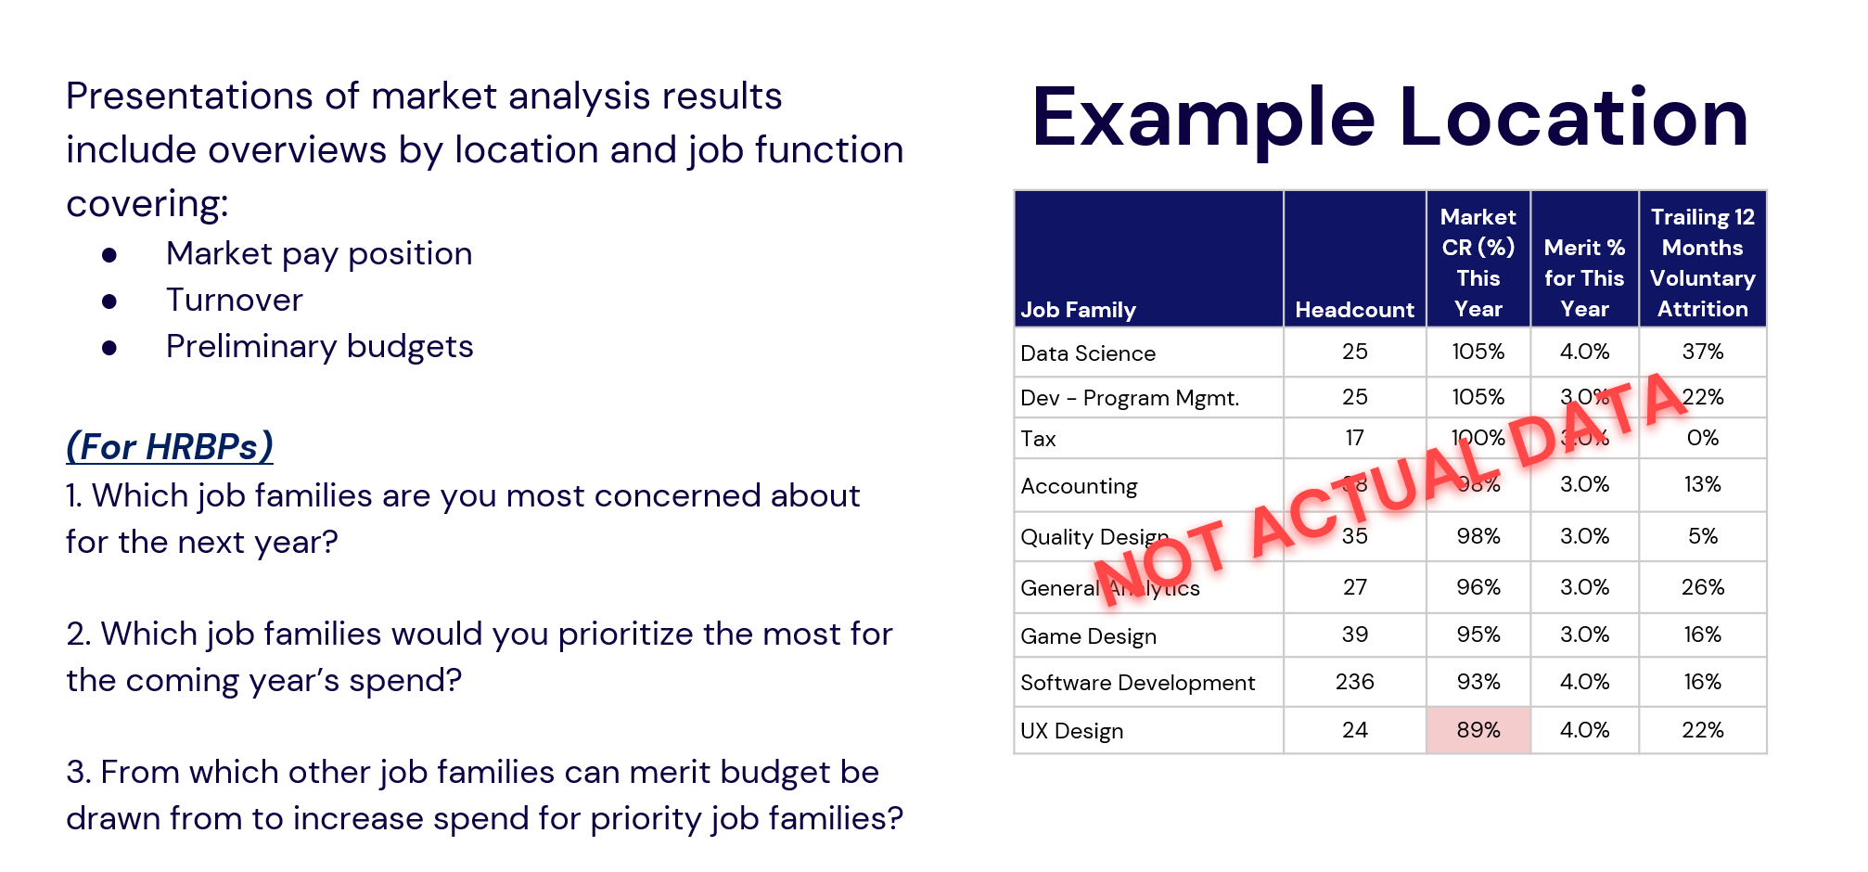
What We’ll Be Sharing
For Illustration Purposes Only*

Slide 16
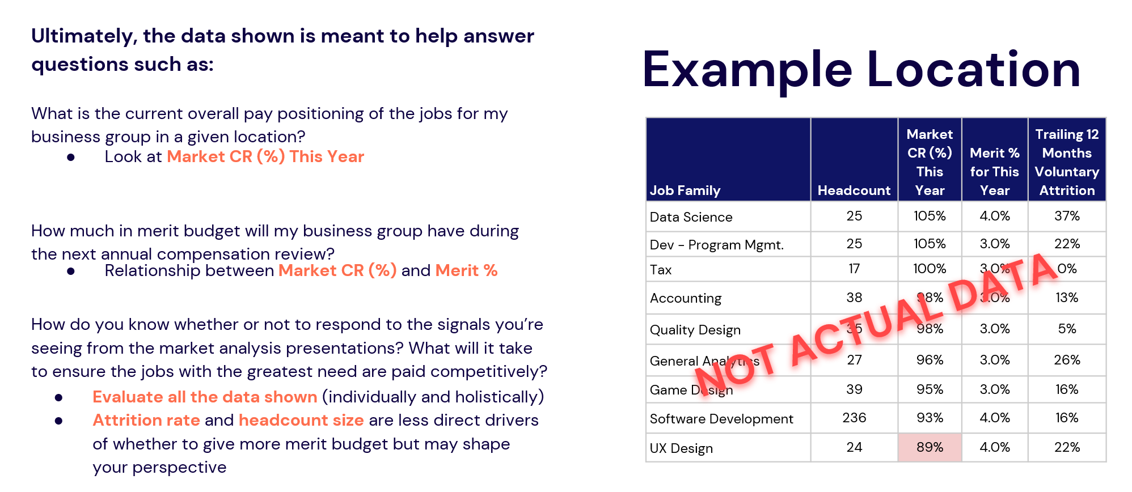
How to Interpret Market Analysis Results
For Illustration Purposes Only*

Slide 17
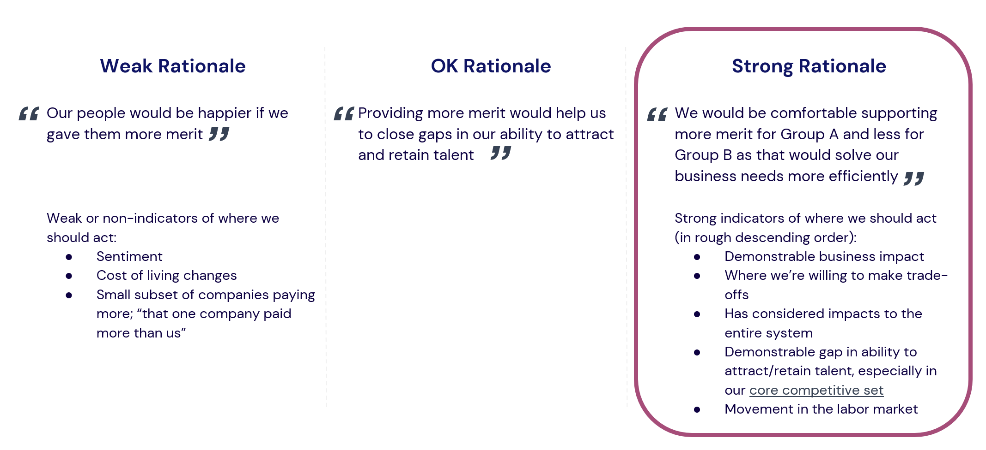
Recommendations for How to Create a Strong Business Rationale
For Illustration Purposes Only*

Slide 18
APPENDIX

Slide 19

SUPPLY and DEMAND
Market studies help us learn about supply & demand (competition for jobs). Pay can decrease or increase over time if there is an oversupply or decline of qualified candidates or a decrease or increase of demand for certain jobs.
Ex: 1 Geologist jobs declined when oil companies drop their oil prices.
Ex 2: The demand of cyber security jobs increased, due to past security breaches, hacks and legislation. Media companies have been paying above market to attract and retain these key talent.
Ex 3: Demand of IT jobs have boomed due to due dot.com in the 2000s.

Slide 20
Surveys Participation
Compensation surveys collect pay data from participating companies.
This pay data includes information on base salary, bonuses, and equity for benchmark jobs. Benchmark jobs refer to common positions that are likely to exist in all companies, such as Accountants, HRBPs, Engineers, Sales Managers, etc.
Some survey vendors also provide complimentary practice reports that assist companies in setting their budget for promotions, merit, retention, and market adjustment cap percentages. Additionally, they offer non-compensation data, such as benefits, attrition, new hires, retention data.
Survey vendors equip companies with thorough compensation reports, guiding them on how to:
Benchmark their internal job positions' pay against their target market pay. This can be based on various percentiles such as the 25th, 50th, 75th, etc., depending on the company's compensation philosophy.
There are three primary surveys companies participate in:
General Industry
Industry-Specific Survey
Custom Survey

Slide 21
Selecting Surveys
Industry Specific Surveys
Industry-specific surveys are tailored to specific sectors.
Companies may opt for an industry-specific survey if a relevant one is available.
These surveys encompass a broader range of professions and aren't tied to a specific industry.
Companies often chooses 1 or 2 of these general surveys to cover common benchmark roles, such as accounting, human resources, legal, and facilities management positions.
Custom surveys Used in Special Circumstances
Custom surveys are designed to gather very specific data.
Custom surveys can be costly and demand significant time and effort.
Some companies that we favor, might choose to participate, while others may decline.
Peer Group Cut Survey
This approach involves the org identifying which companies they are in competition with for talent.
By pinpointing a specific set of peer groups, they can then benchmark their internal data against these entities to ensure they remain competitive in the talent market.

Slide 22
Comp Key Terms
Market Study – the process by which we compare the pay for our jobs against what other companies with similar jobs are paying
Benchmark Job – a job commonly found in the market
Compensation Factors – details about a job that influence how the job is paid (years of experience, education, skills, responsibilities, travel percentage, etc.)
Labor Market – is the industry, the size of the organization, and the location we compete to hire employees. It is also called “Talent Market.”
Percentile – a point on a rank- ordered scale, found by arranging a group of data points in order of magnitude from lowest to highest. The first percentile approximates the very lowest number found, while the 100th P is the very highest. Our target percentile is the exact point in the market where we intend to pay proficient employees. Ex: 90th percentile means 10% of industry is paying higher than what you are paying for the benchmarked job
Comp- Ratio – how an employee pay rate compares to the midpoint of their range (Pay Rate divided by Range Midpoint)
Position in Range– an individual pay compared to the complete pay range, or how fair a pay range an employee’s pay has progressed (Pay Rate minus Range Minimum) divided by (Range Maximum minus Range Minimum)
Compression– wage compression is a phenomenon that occurs when a new hire is paid the same as or more than employees with more seniority in the same job

Slide 23
Comp Key Terms
Red-Circled Employee- is one whose pay has exceeded the maximum of the range for their job
Green-Circled Employee- employee is one whose pay is below the minimum of the range for their job
Internal Pay Equity- exists when employees at an organization perceive that they are being rewarded according to the relative value of their jobs.
External Pay Equity- exists when an organization’s pay rates are equal to the average rates in the organization’s market or sector
COLA- Cost of Living Adjustments. An across-the-board salary increase, or supplemental payment intended to bring pay in line with inflation in a geographical area
Cost of Labor- is what an organization pay employees to do a job/produce work for said organization
Merit Increase is a performance-based raise to an employee’s pay
Market Adjustment is an increase to the employee’s pay based on market movement.
Merit Matrix- a pay for performance tool used to determine pay increases for individuals based on their performance and position in range (or range penetration).
Non-Exempt Employees are those who are subject to the minimum wage and overtime pay provisions of the Fair Labor Standards Act (FLSA).
Exempt Employees are those who are not subject to FLSA minimum wage and overtime provisions.

Slide 24


Common FAQs
Q: What is the difference between Pay Equity and Pay Equality?
A: Pay Equity is equal pay for equal work of equal value. In some states, job evaluation and job classification are required. Pay Equality is where employees can earn the same pay based on broader diversity initiatives.
Q: Can pay influence performance?
A: Comp is only a component of performance. Learning and development, constant feedback, check ins with managers, training, company moral, trust building all impact performance.
Q: Why do we use surveys instead of Glassdoor?
A: Glassdoor reviews contain feedback from employees (which might be biased or fake). Surveys are more credible and have a great reputation for their general industry and media data.
Q: Why do companies use Salary Grades or Bands?
A: They are structures that allow companies to efficiently administer its jobs' market pay levels, salary adjustments (merit, promotions, off-cycle) and can be used for career path discussions
Q: What is the difference between market adjustment & merit increase?
A: Merit increase is based on performance. Market adjustment is a one-time variable pay. If an employee gets 6% merit increase and a 12% market adjustment increase, we don’t want the employee to conflate the two and expect an 18% increase every year.

Slide 25



